Slide 1
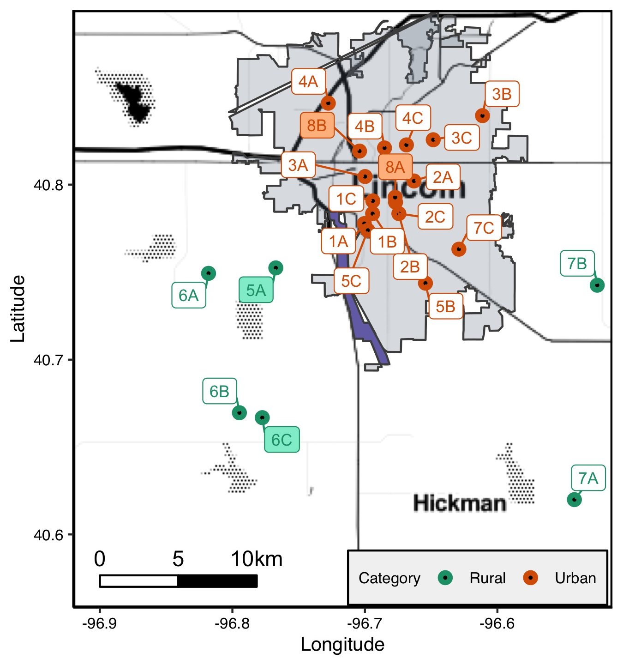
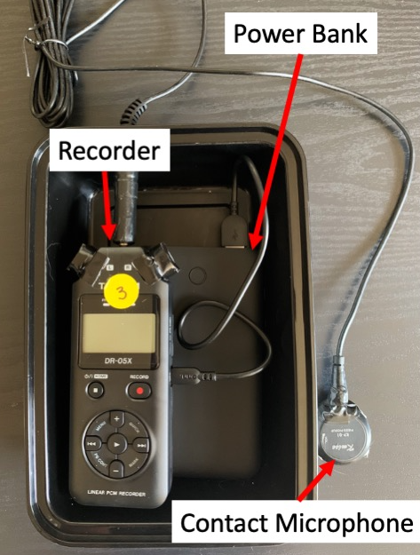
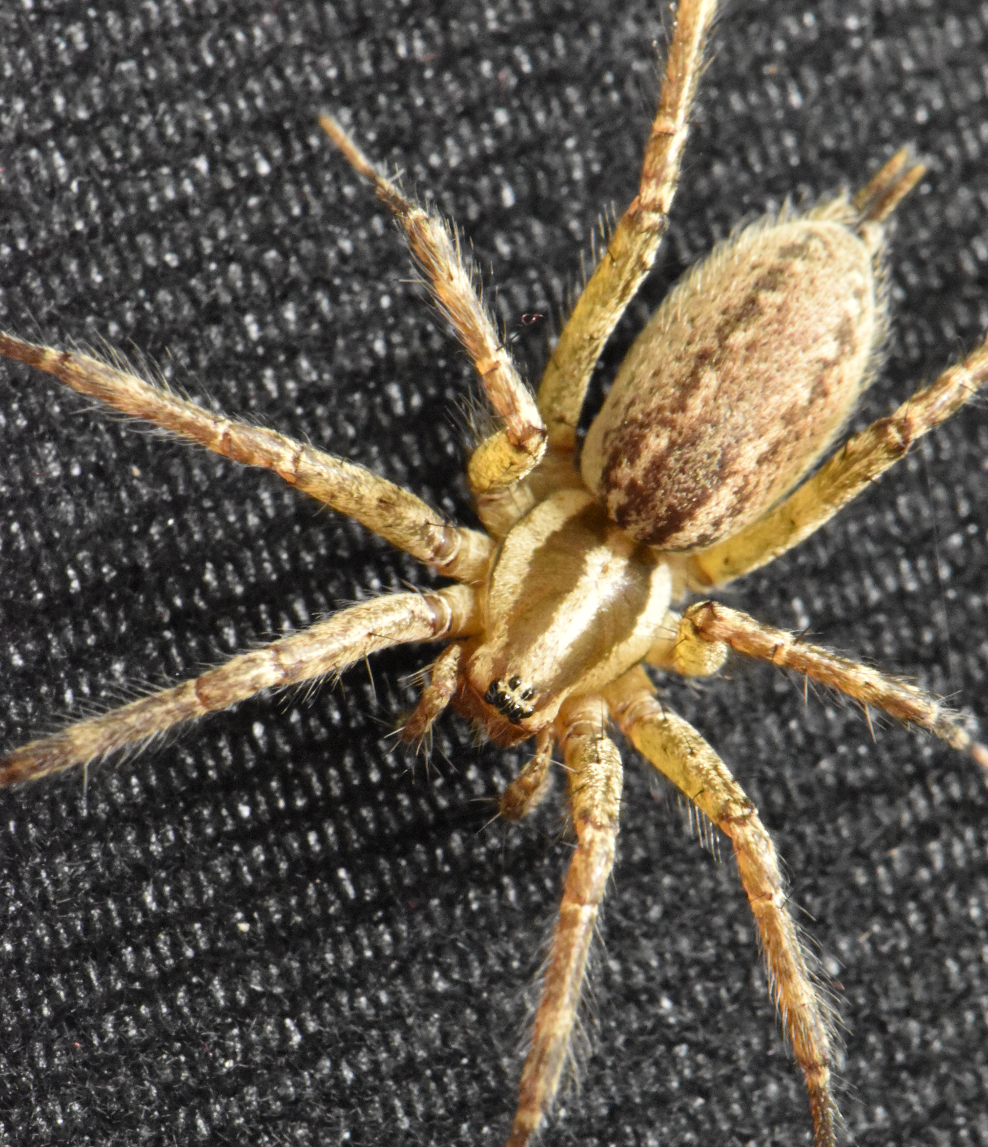
A
B
Portable Battery
Recorder
Contact Microphone
C
Figure 1. Map of Lincoln, Nebraska, USA and the surrounding area (A) marked with sites where substrate-borne (vibratory) noise was recorded using recording units (B) at the location of Agelenopsis pennsylvanica (C) webs. Greem points represent rural sites and orange points represent urban sites (based on land cover, see Figure S1A). Most recordings occurred in 2020, while recordings at sites 8A and 8B occurred in 2022. Shaded site labels indicate sites where A. pennsylvanica were collected for the choice test. The purple area shows Wilderness Park, where some A. pennsylvanica were collected for activity monitoring.

Slide 2
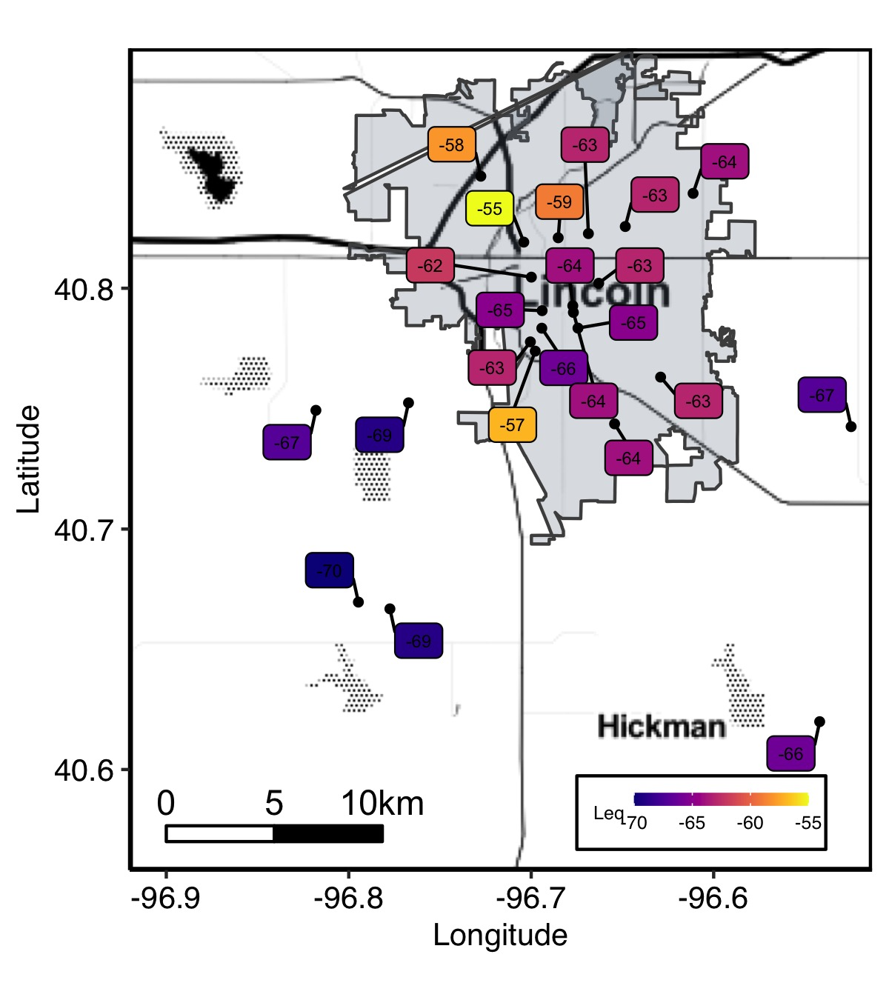
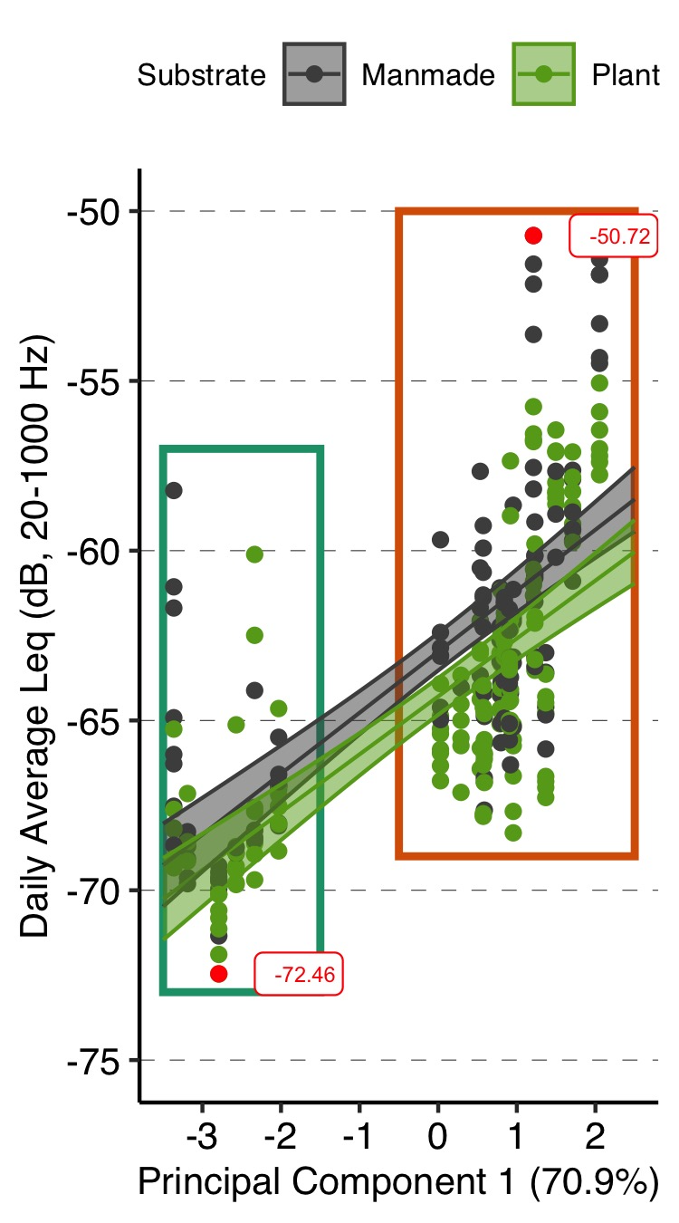
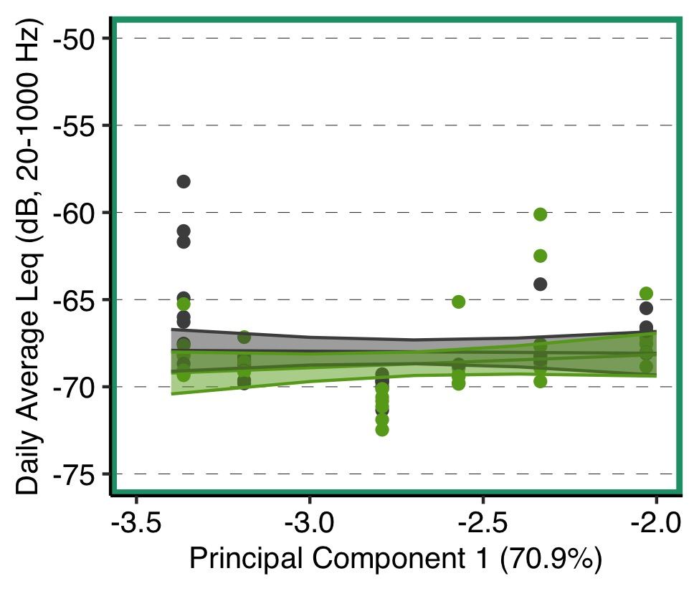
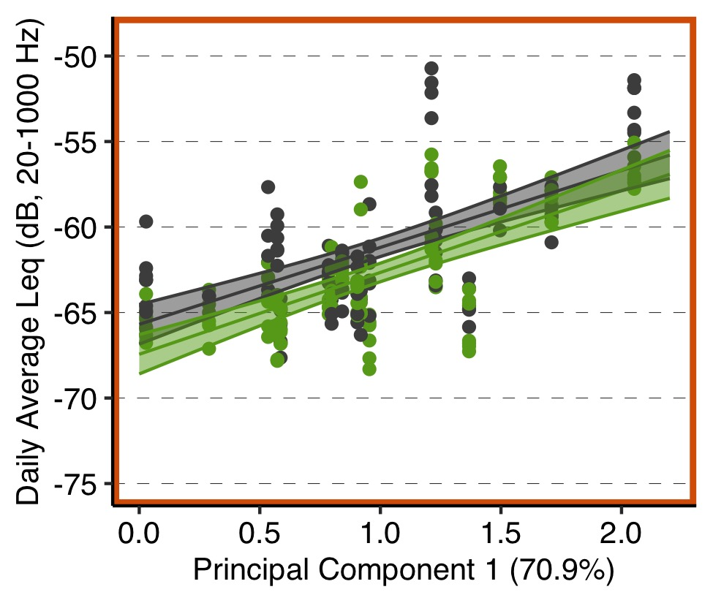
A
B
Urban
Rural
C
D
Figure 2. Results of spatial analysis of vibratory noise. Site mean of the daily average Leq across all 23 sites is given in the text label and represented by color (A). Raw data points and mean (± SE) predictions from linear mixed effect (LME) model of daily average Leq by principal component 1 (see PCA in Figure S1B-C) and substrate (grey = manmade, green = plant) with site as a random effect for data overall (B), for rural sites (C, robust LME), and for urban sites (D). Green boxes represent rural sites and orange boxes represent urban (B-D). The red dots and text show the lowest and highest daily average Leq reading (B).

Slide 3
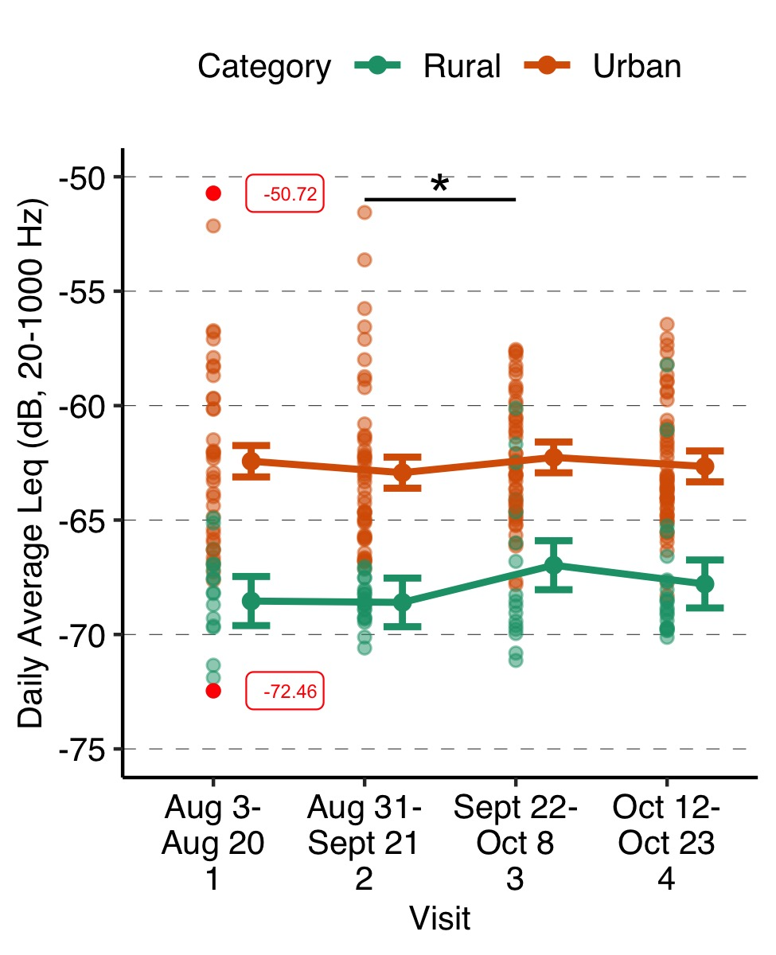
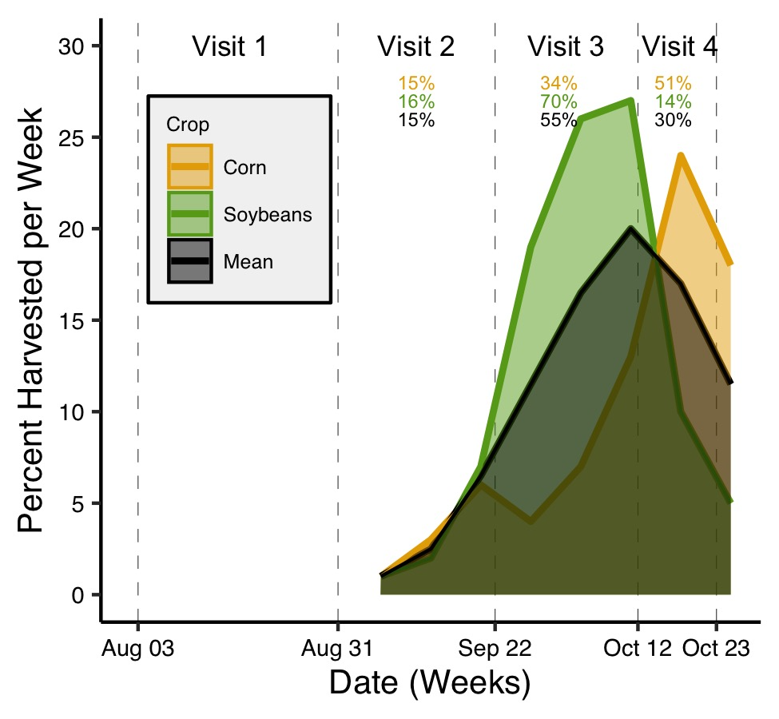
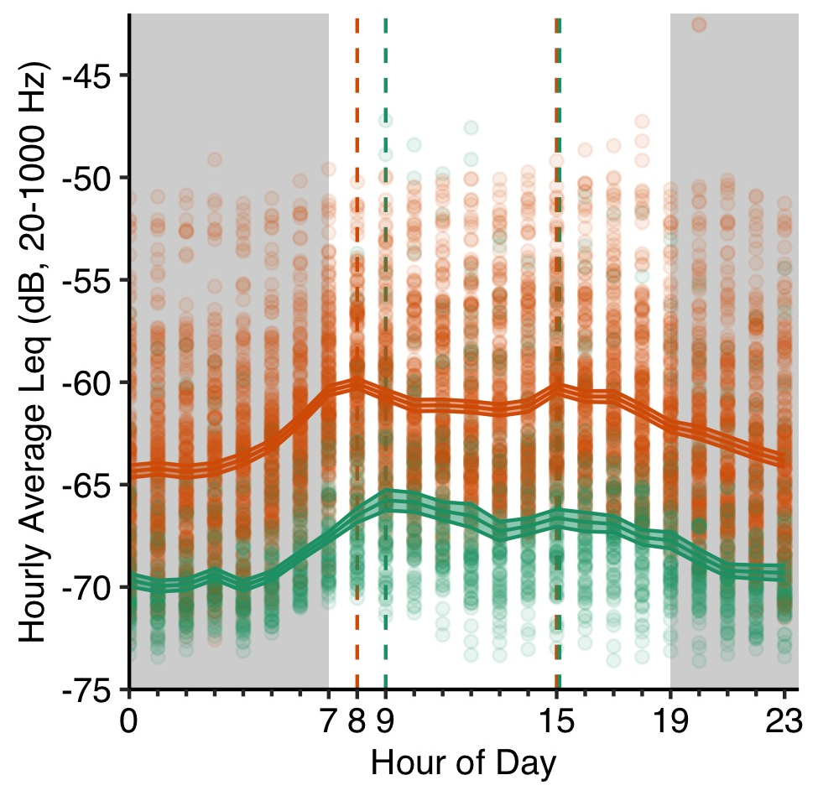
A
B
C
Figure 3. Results of temporal analysis of vibratory noise in 2020. Raw data points and mean (± SE) predictions from linear mixed effect (LME) model of daily average Leq by visit (1-4 throughout Agelenopsis pennsylvanica penultimate juvenile/adult season) and category (green = rural, orange = urban) with site as a random factor (A). The red dots and text show the lowest and highest daily average Leq reading (A). Line and asterisk (P < 0.05 *) indicate the results of a Tukey pairwise comparison post hoc test (A). USDA data on percent of annual crops harvested at the end of each week in 2020 across Nebraska for two major crops in Lancaster County, Nebraska: corn and soybeans (B). Vertical lines show the boundaries of each visit for vibratory noise recording (B). Percentages represent the percent of the harvest of the associated crop that occurred during the visit (B). Raw data and calculated mean (± SE) hourly average Leq across 24 hours by category (C). Vertical dashed lines represent peaks of associated category (C).

Slide 4
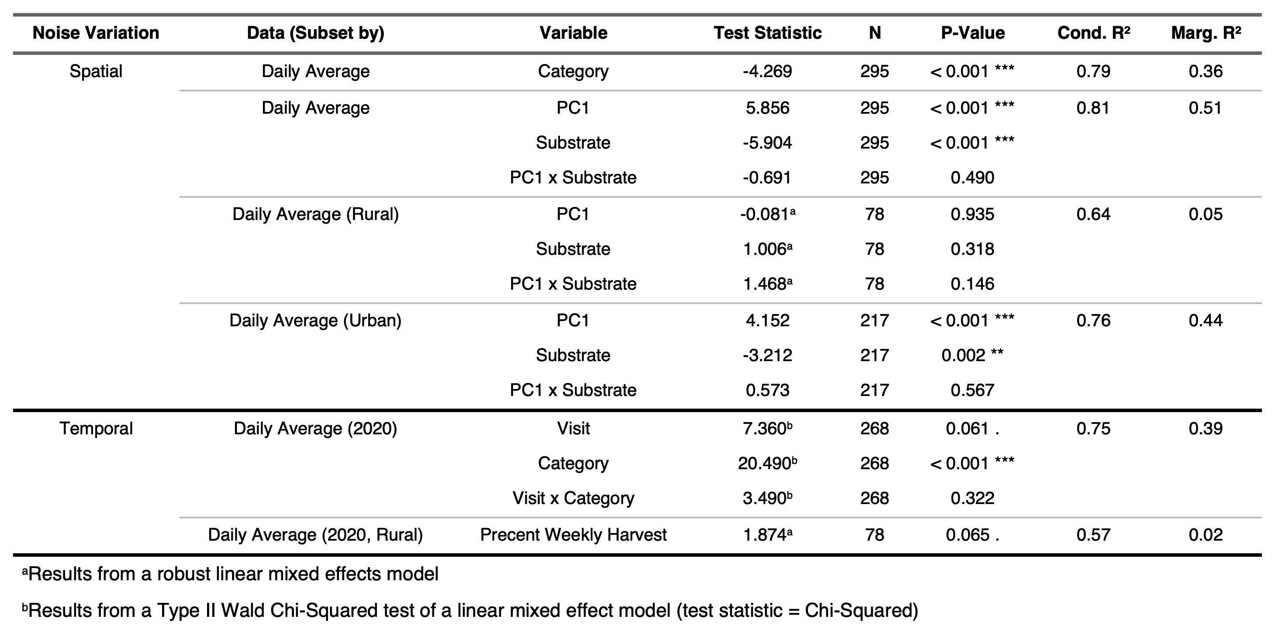
Table 1. Results of linear mixed effect (LME) models (site as a random factor) assessing spatial and temporal variation in vibratory noise. Asterisks indicate significance (P < 0.001 ***, P < 0.01 **, P < 0.05 *, P < 0.10 .). Test statistic is a t-value unless otherwise noted.

Slide 5
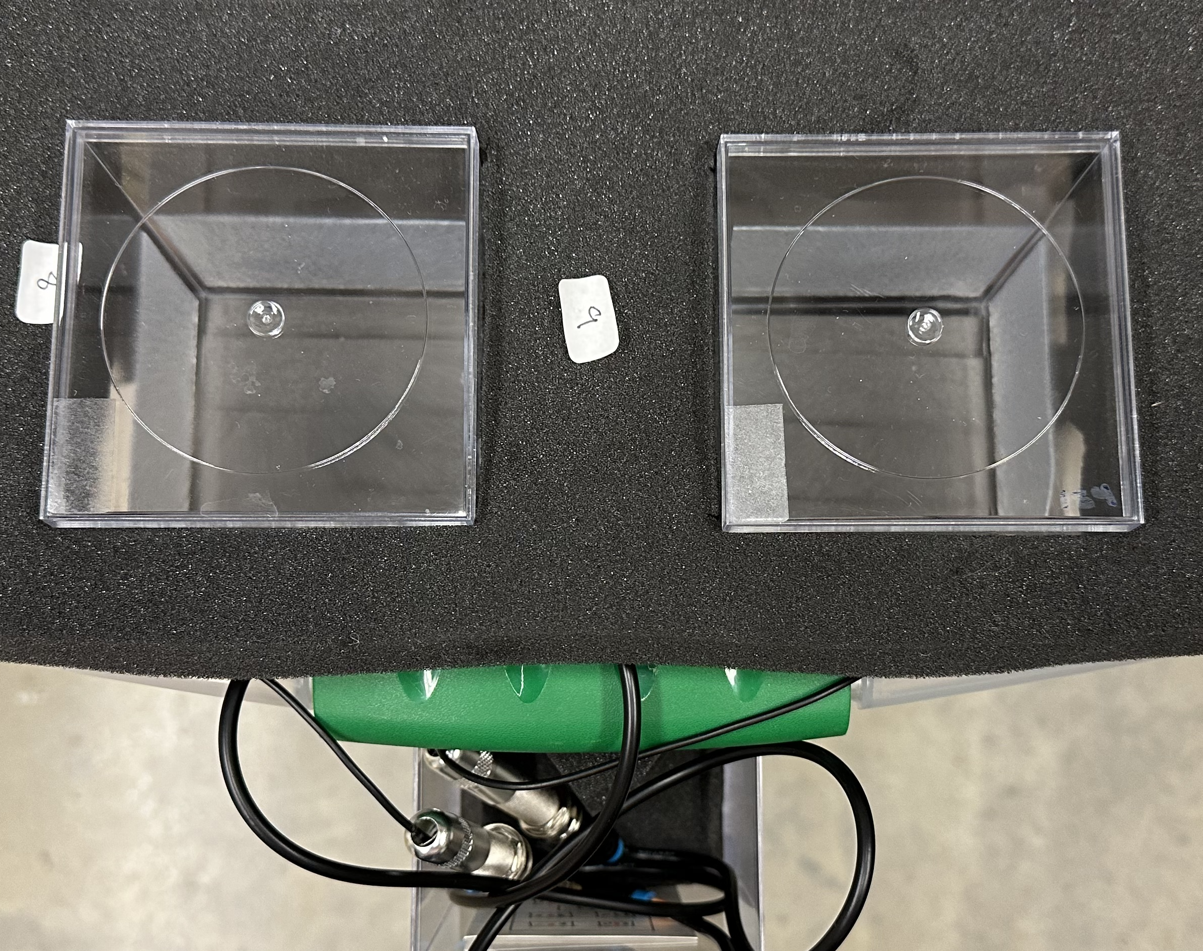
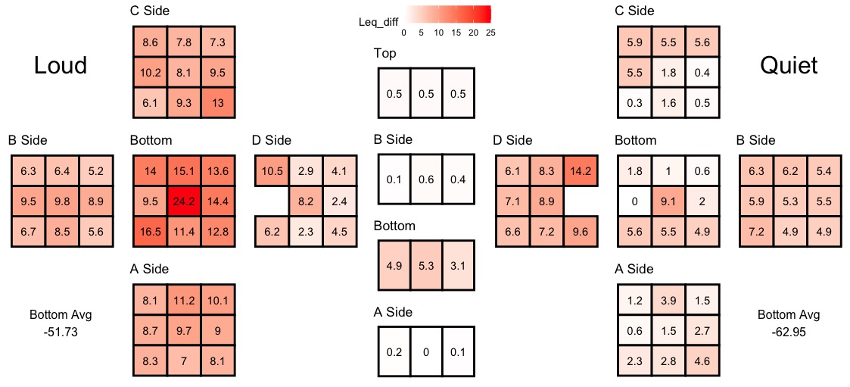
A
8.3 cm
B
8.3 cm
5
cm
8.3
cm
2.6 cm
5.8 cm
Top View
C
Side
Relative
Leq
Side
Loud
Side
Top
Quiet
Side
Side
Bottom
Side
Side
Side
Bottom
Side
Bottom
Side
Side
Bottom Avg.
-51.73
Side
Bottom Avg.
-62.95
Figure 4. Experimental setup of the choice chamber. The chamber was constructed from two large and one small (tunnel) clear acrylic containers (A) suspended in acoustic foam (B), with a piezo electric contact microphone attached to the bottom of each large container. The results from testing the resultant vibrations are displayed in C. We recorded vibrations for thirty seconds during playback at points all across a chamber. We set the quietest recording to 0, and the colors and numbers represent the relative increase in Leq (dB) from the quietest position.

Slide 6
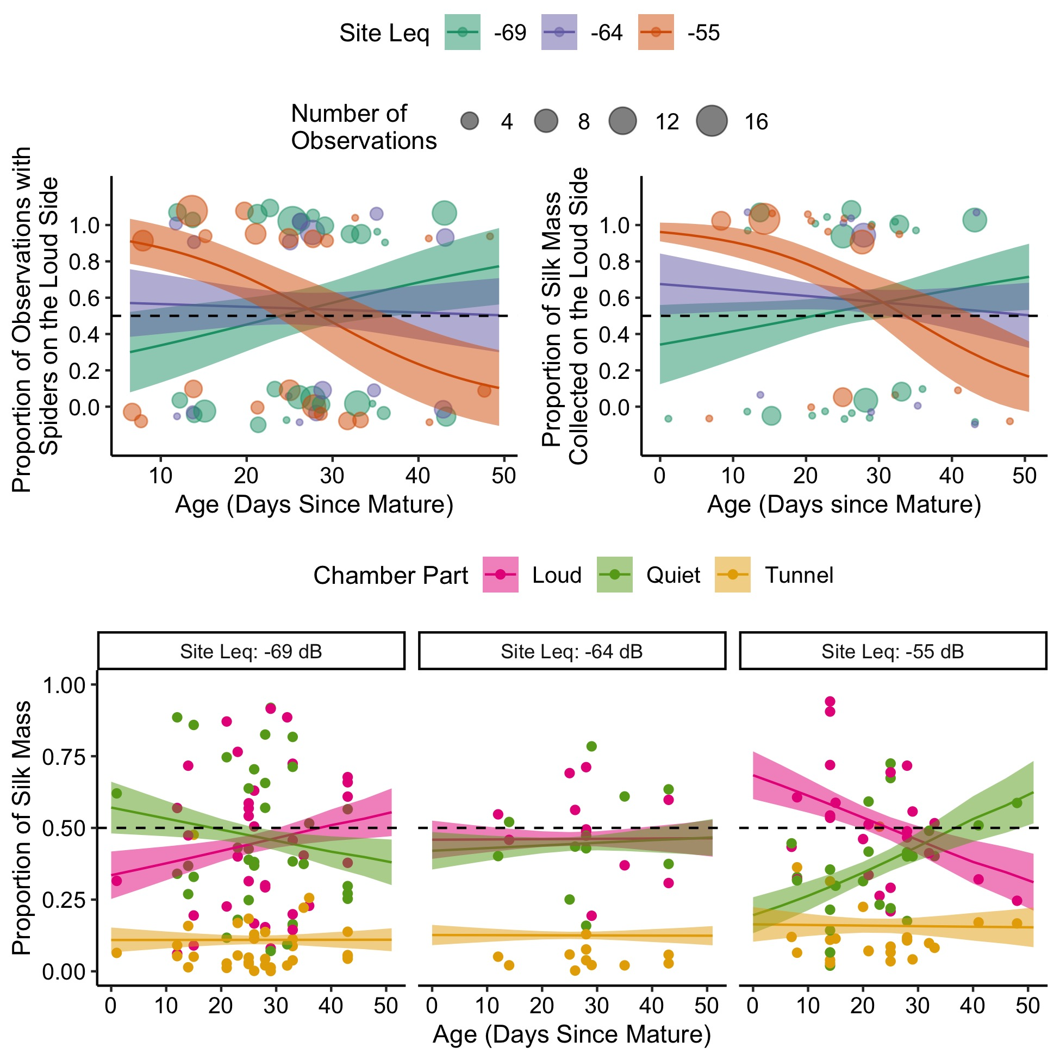
A
B
A
C
Figure 5. Results of choice chamber experiment. The proportion of observations of spiders’ positions (A) and proportion of dry silk mass (B) found on the loud side (vs the quiet side) of the choice chamber for spiders of different ages and from sites with different vibratory profiles (Leq). The proportion of total dry silk mass found in the chamber parts (loud, quiet, or tunnel) for spiders of different ages and from sites with differing Leq (C). The lines and error ribbons represent the mean and standard error from the model predictions, respectively. Points represent the raw data. Since A-B represents binomial data (i.e. crowding of points at 0 and 1), point size represents the number of observations at that age. Lack of choice is represented by the dashed line at 50%.

Slide 7
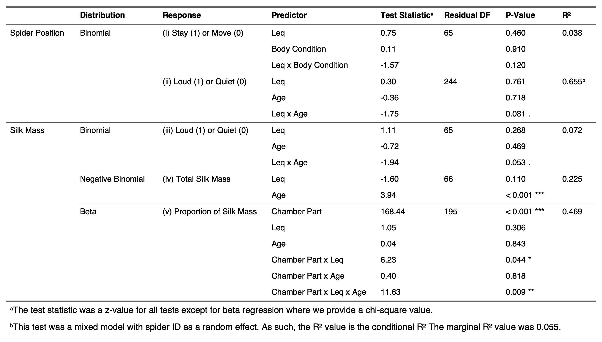
Table 2. Final model results of the statistical analyses investigating predictors of spiders’ choice of vibratory environment.

Slide 8
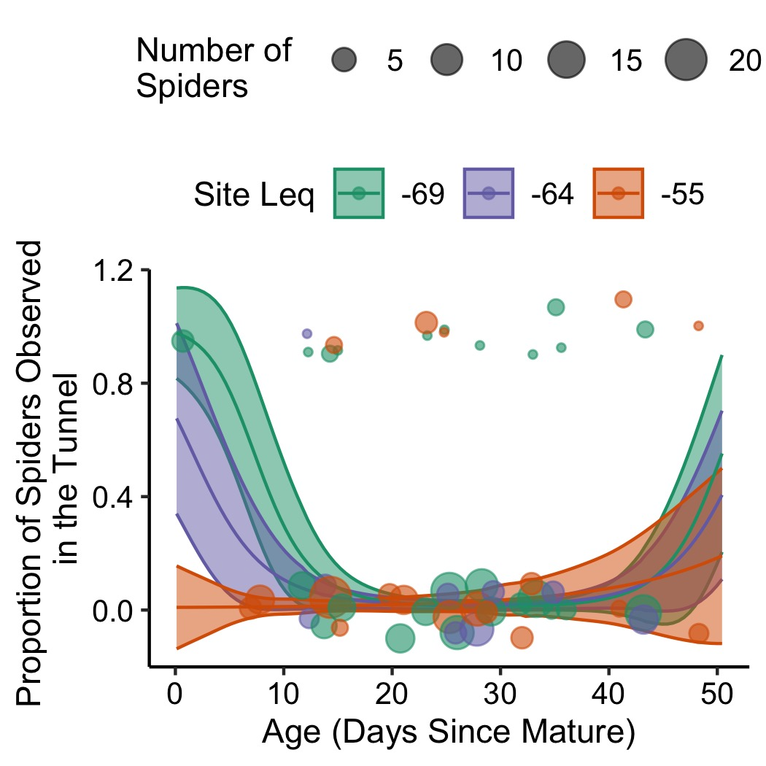
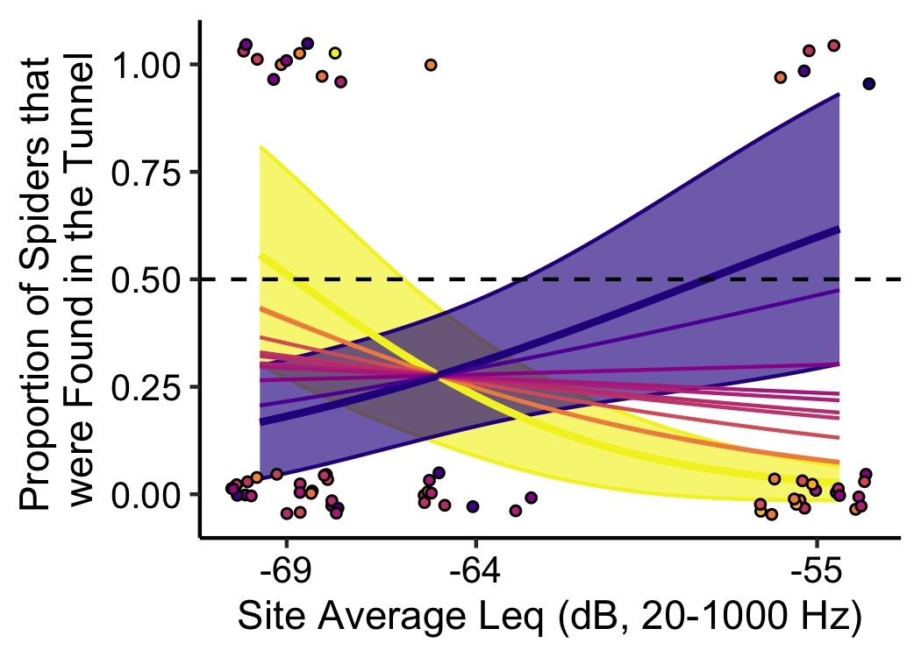
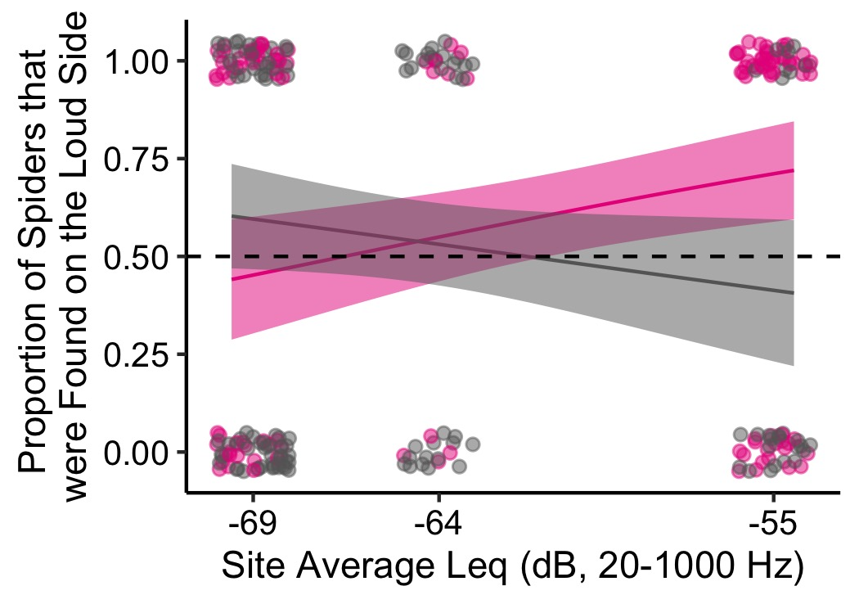
Quiet (0)
Loud (0)
Tunnel (1)
Quiet (0)
Loud (1)
Tunnel (-)

Slide 9
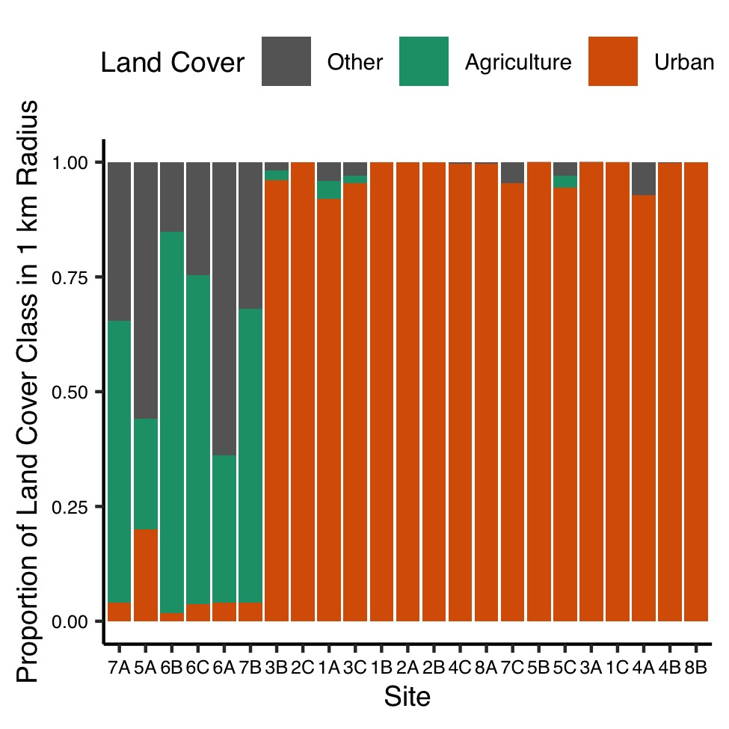
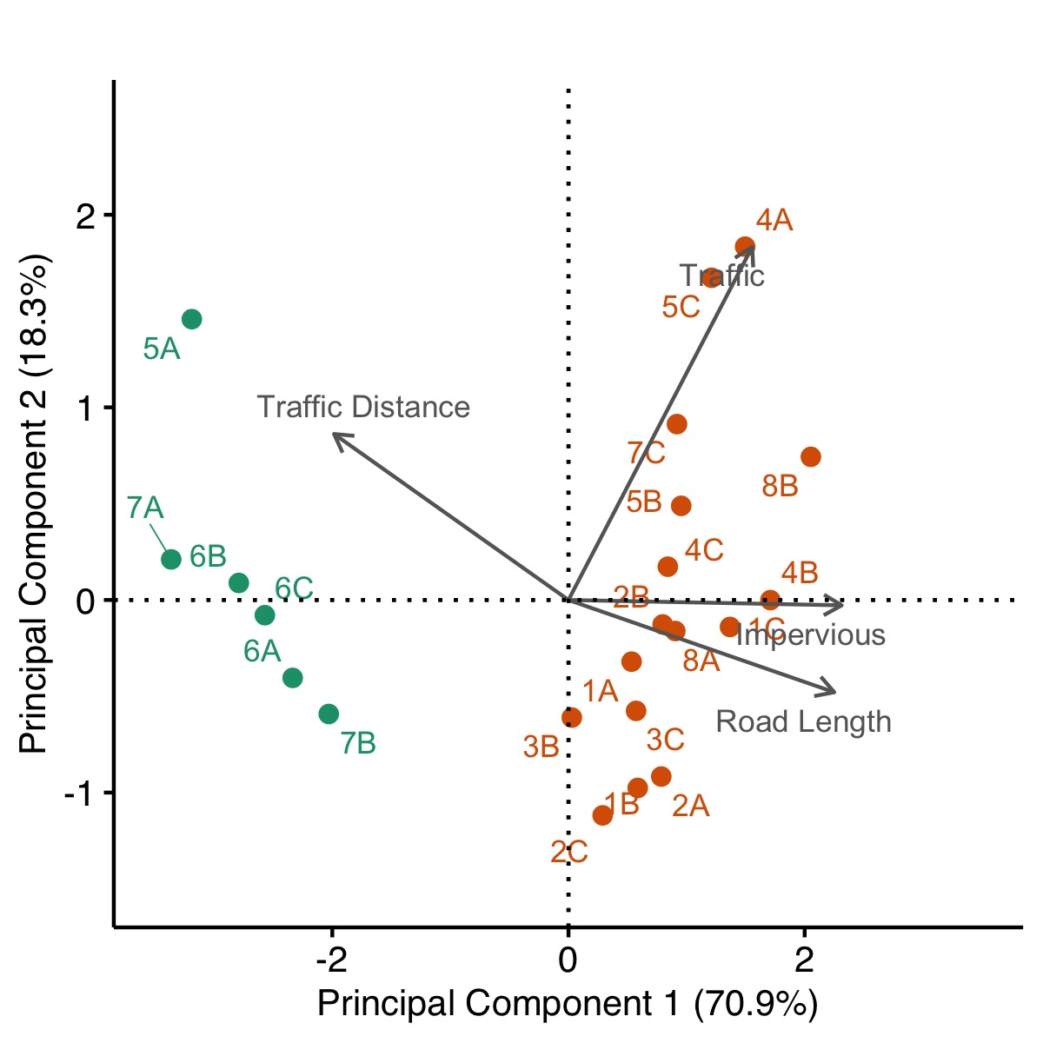
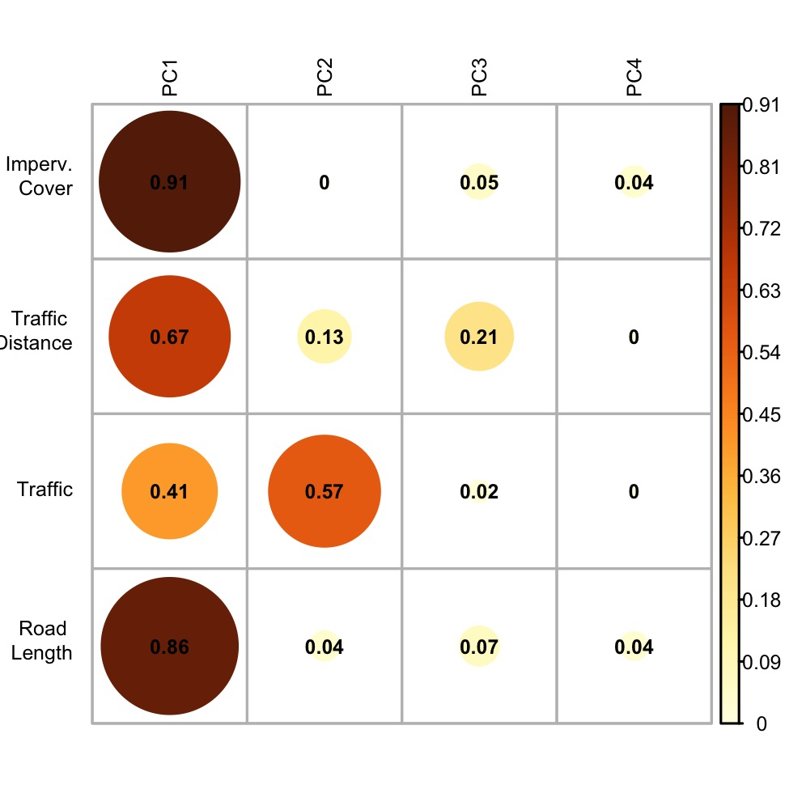
A
B
C
Figure S1. Categorization (A) and Principal Component Analysis (B-C) of sites. Proportion of land cover class in a 1-kilometer radius of each site (ordered by PC1 axis in B) from the National Land Cover Database (NLCD) 2019 (A). Agriculture includes NLCD categories Pasture/Hay and Cultivated Crop. Urban includes NLCD categories Developed Open Space, Developed Low-Intensity, Developed Medium-Intensity, and Developed High-Intensity. Other includes all other NLCD categories (the majority here is Grassland/Herbaceous. Sites with more agricultural land than urban land are categorized as rural and the rest urban. Principal Component Analysis using variables related to the potential impacts from traffic (B). Plot of the contributions of each variable to each principal component (C). The numbers and colors represent the cos2 for the variables.

Slide 10
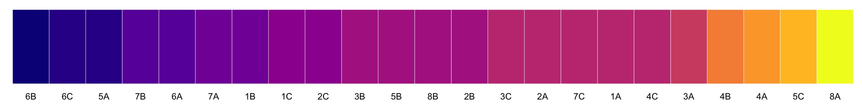
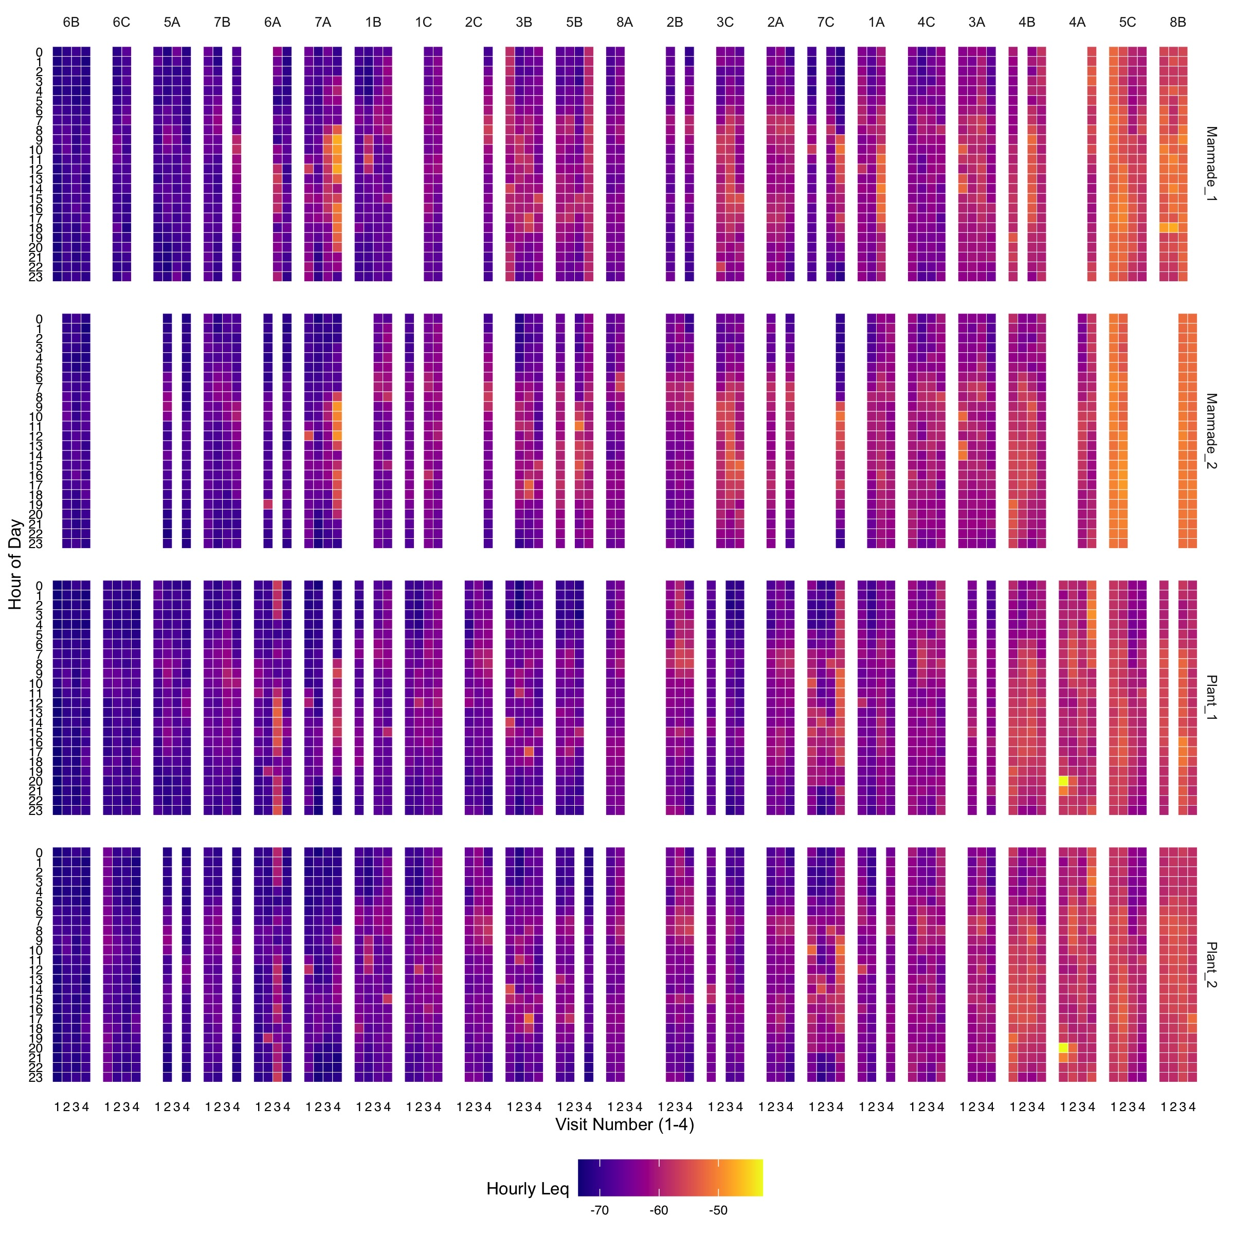
Figure S2. Heat map depicting the hourly average Leq (dB, 20-1000 Hz) for all recordings. At the top, sites are in order from quietest to loudest with representative colors (matches Figure 2A). Visits are represented horizontally and the hour of the day vertically. Both contact microphones on manmade substrates are shown in the top two rows while those on plants are represented in the bottom two rows with separate rows for each microphone.

Slide 11
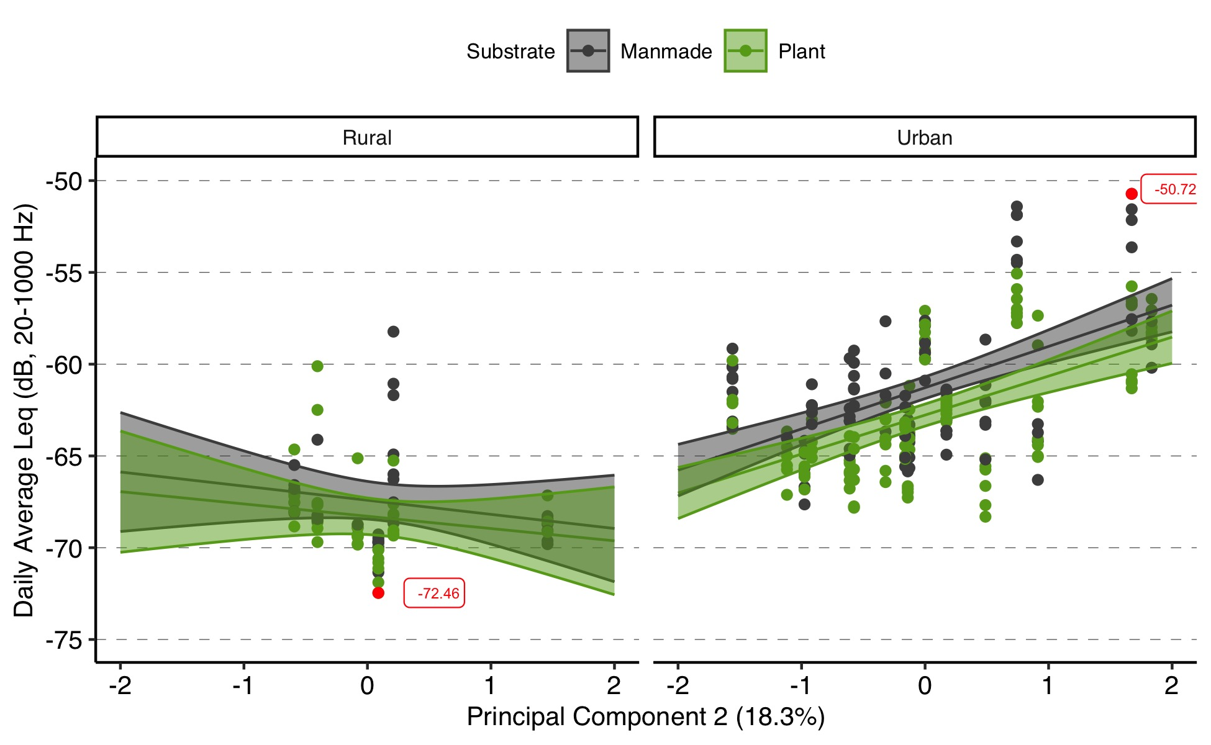
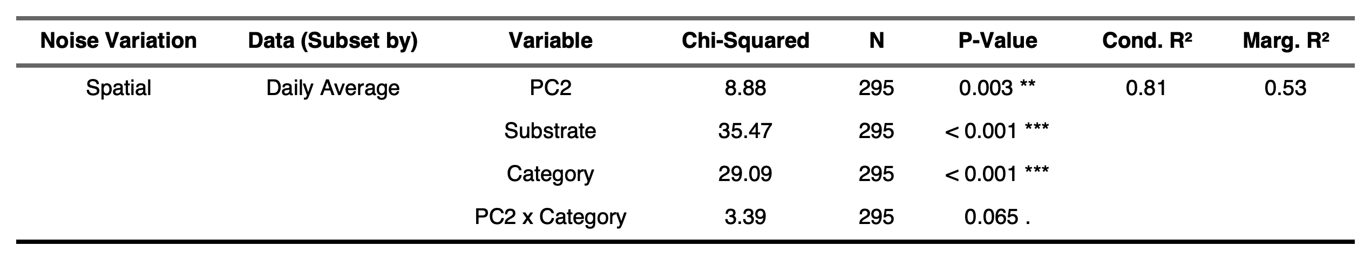
Figure S3. Raw data and mean (± SE) predictions from linear mixed effect models with PC2 (see PCA Figure S1B), substrate (grey = manmade, green = plant), and category with site as a random factor after backward selection. Table of results from the Type II Wald Chi-Squared test of the LME model with variables remaining after backward selection.

Slide 12
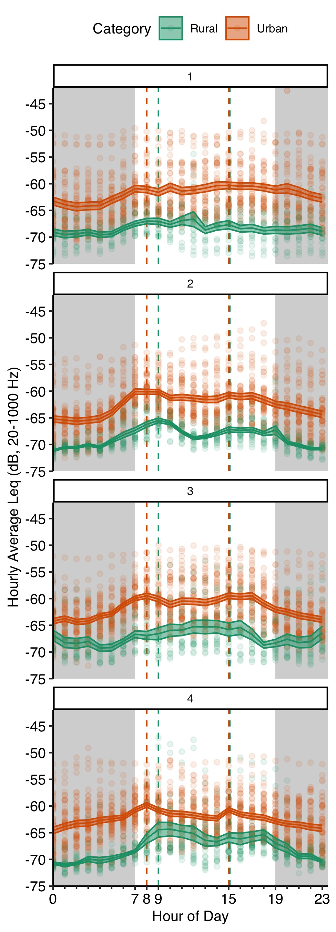
Figure S4. Raw data and calculated mean (± SE) hourly average Leq across 24 hours by category for each separate visit. Vertical dashed lines represent peaks of associated categories from data overall.

Slide 13
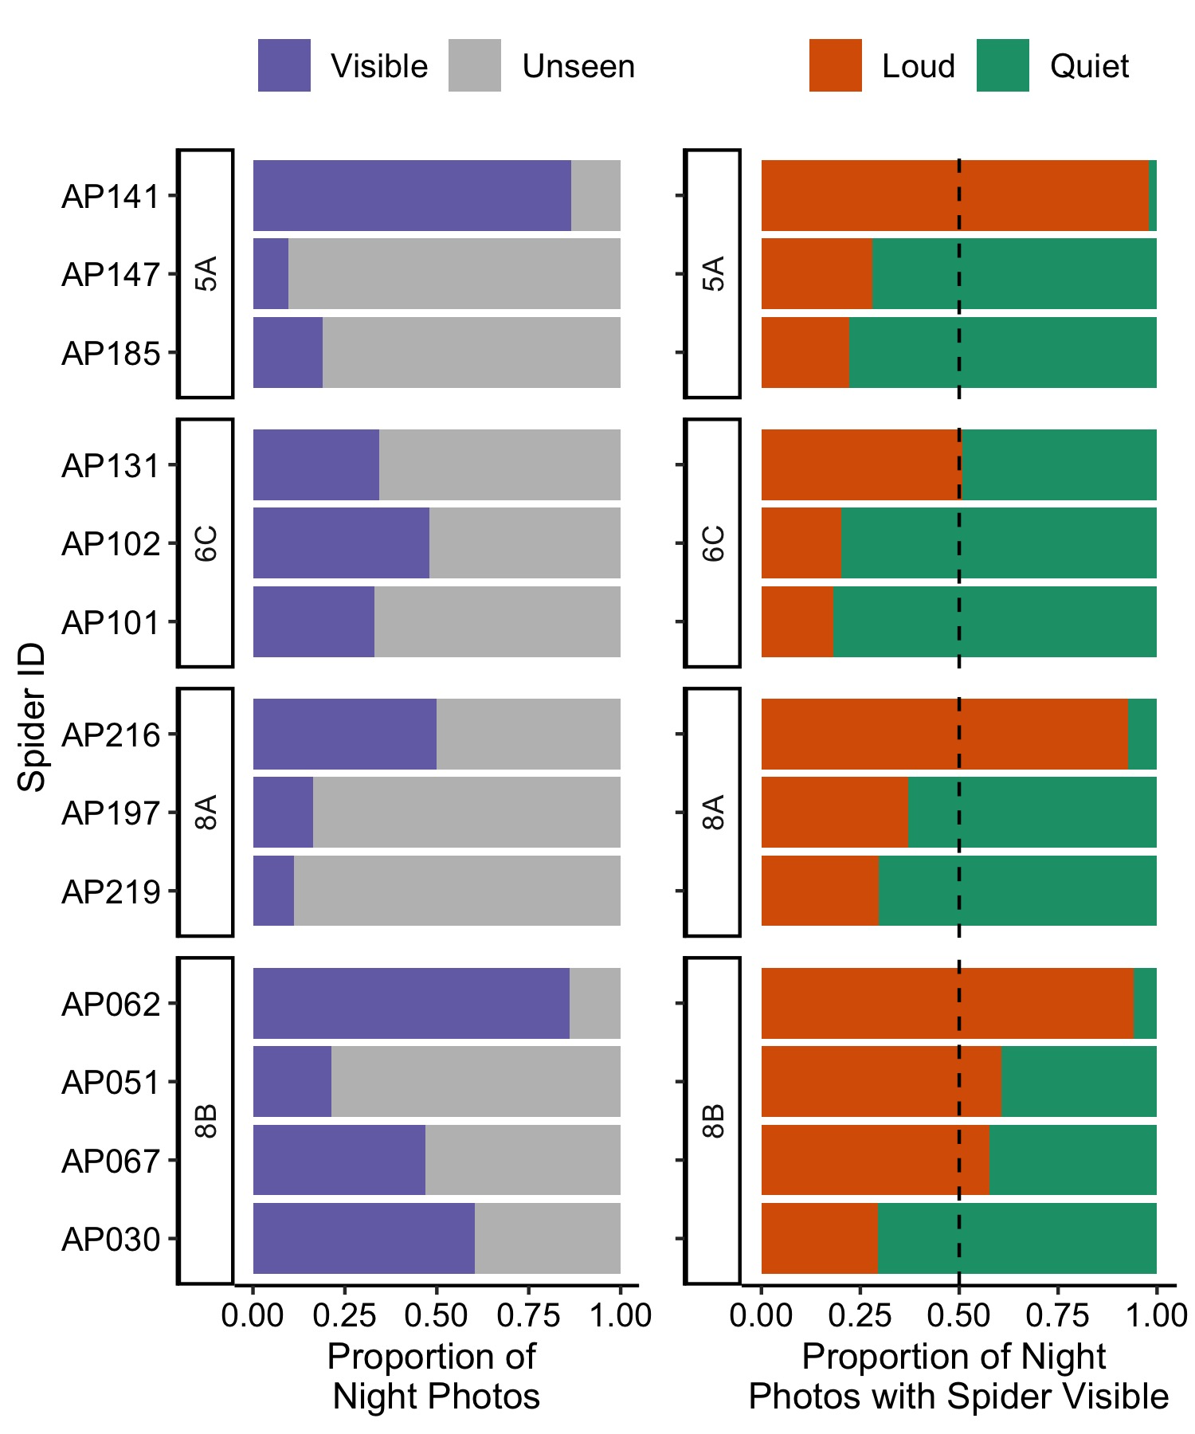





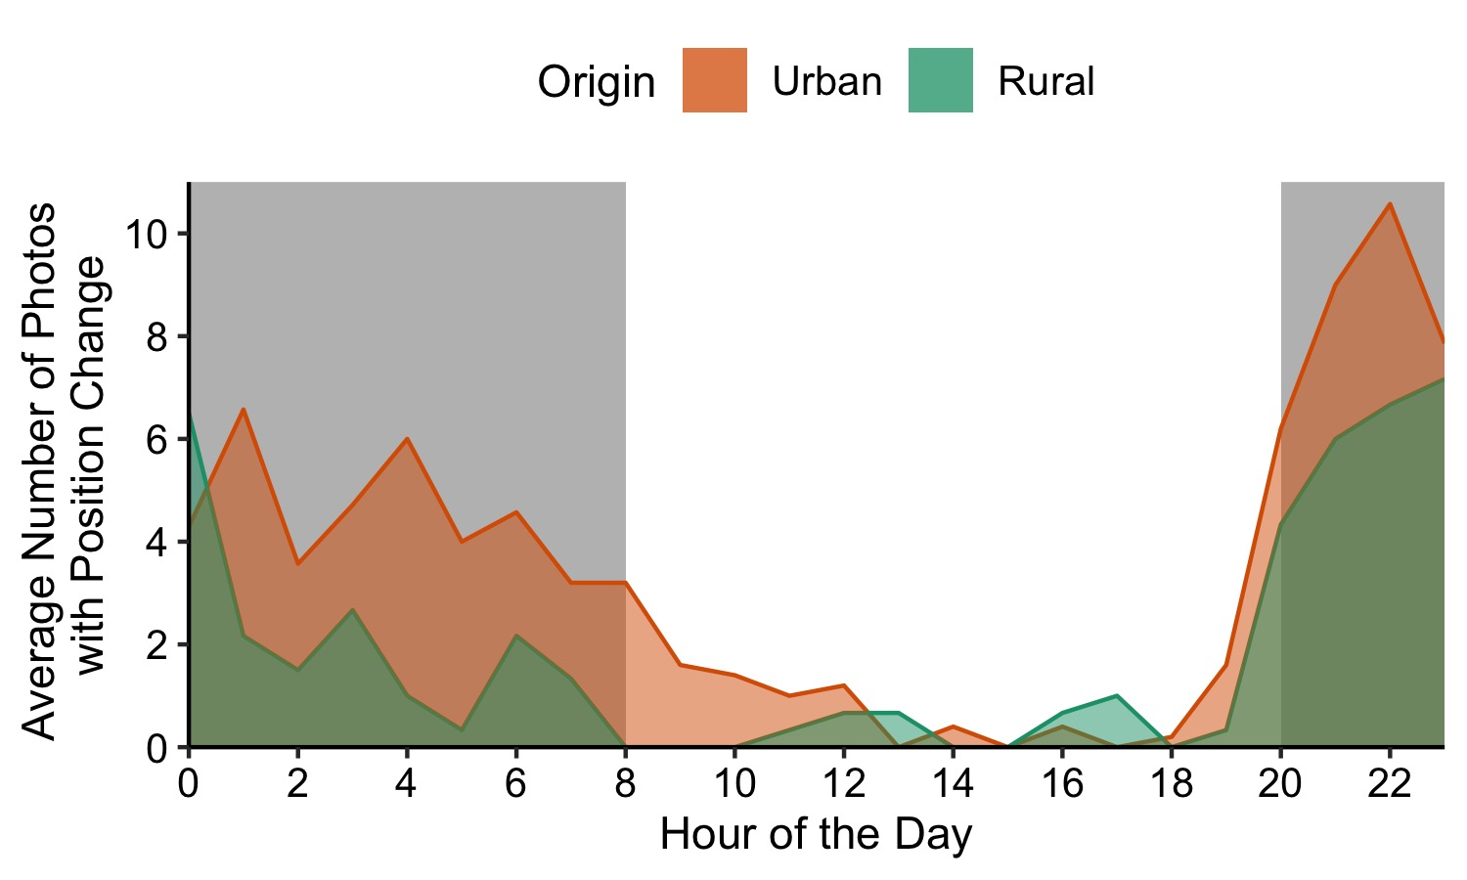
A
B
First
Observation
Final
Silk Mass
C
Figure S5. Visualizations from the raspberry pi images taken every two minutes during the first night of web-building for a subset of tested spiders. The spider is not visible in every image (A), which could be the result of the photo angle or quality or that the spider was in the tunnel which was obstructed from view by the acoustic foam (Figure 4B). Of the images where the spider is visible, no spider was only ever spotted on one side (B), and the side with the highest observations did not always a line with the spider’s first daily position or the side with more dry silk mass. We averaged the number of photos for each spider in one hour time bins where the spider’s position was different from the previous photo (C).

